Slide 1
Creation of website for csit department
Project Guide: Mr. Avinash Amaranayani
Assistant Professor
CSIT Department
D.Joseph Anand [19B81A3315]
P.Shiva Kumar [19B81A3345]
K.Purna Chander [19B81A3330]

Slide 2
Problem Statement
The purpose of department website is to automate the existing manual system by the help of computerised equipment’s and full fledged computer software.
This project is focused on preparing a website for CSIT Department that manages all the departmental information at one place.
This system involves administrator and user.
All the information is updated and managed by the administrator.
Users are students , faculty of the CSIT department or any other external persons can view and utilize the information published on the website.

Slide 3
Existing System
Department of computer science and information technology doesn’t have any specialized website. Currently we are using college website page for uploading and updating departmental information and also we don’t have full access over the server.

Slide 4
Proposed System
In this project we are going to create an independent customizable website for which we can have the full access over the server
This system fulfils the objectives like:
Provides full overview of all the departmental information which includes vision and mission , PEOs and Infrastructure
Showcases achievements , researches and all club activities
Provides access to course outcomes academic calender , Syllabus materials ,Time tables and notices
Provides detailed profiles of all the department faculty

Slide 5
Software Requirements
The Requirements are classified as Front-End , Server Side and Database
Front End
-HTML
-CSS
-Bootstrap
-JavaScript
Server Side
-NodeJs(ExpressJs)
Database
-MongoDB

Slide 6
Phases of Development
Phase One –Information Gathering
Phase Two-Planning
Phase Three-Designing
Phase Four-Development
Phase Five-Preview and Deployment
Phase Six- Maintenance

Slide 7
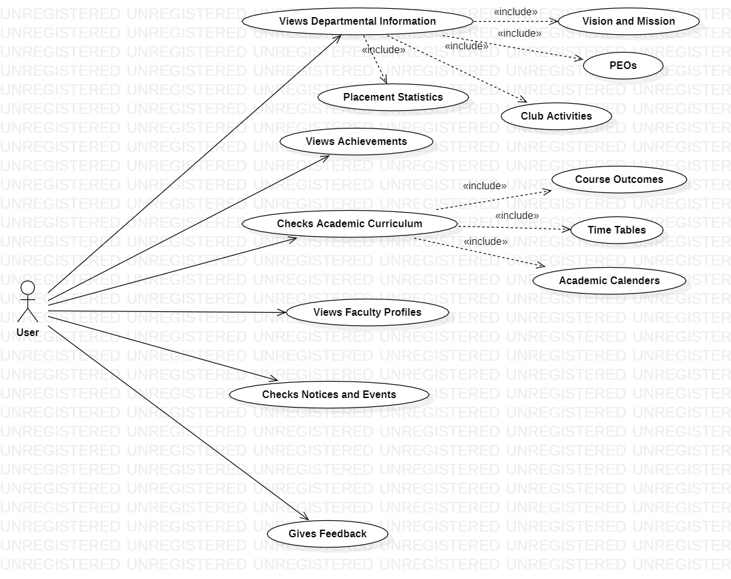
Use Case Diagram For User

Slide 8
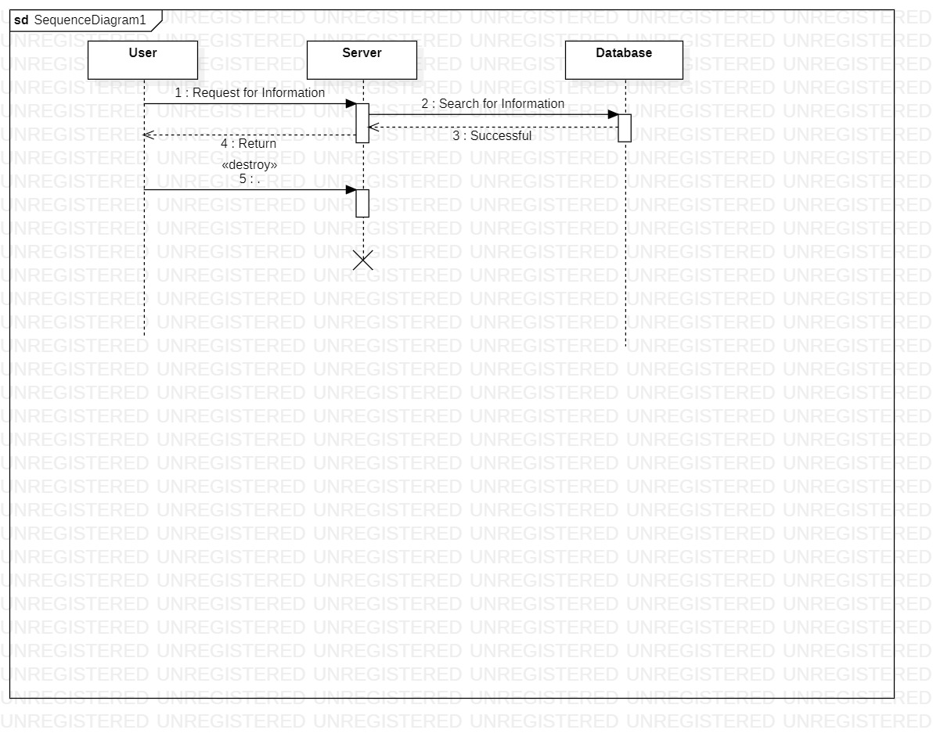
Sequence Diagram For User

Slide 9
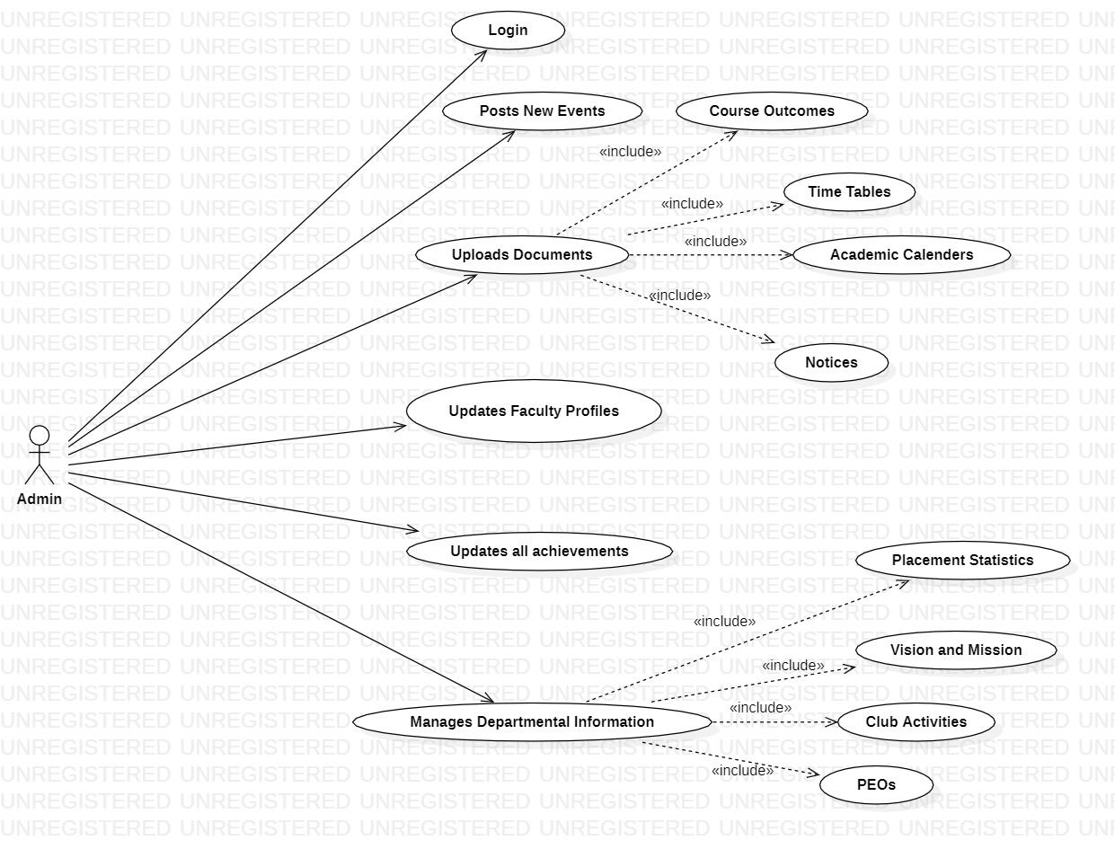
Use Case Diagram For Admin

Slide 10
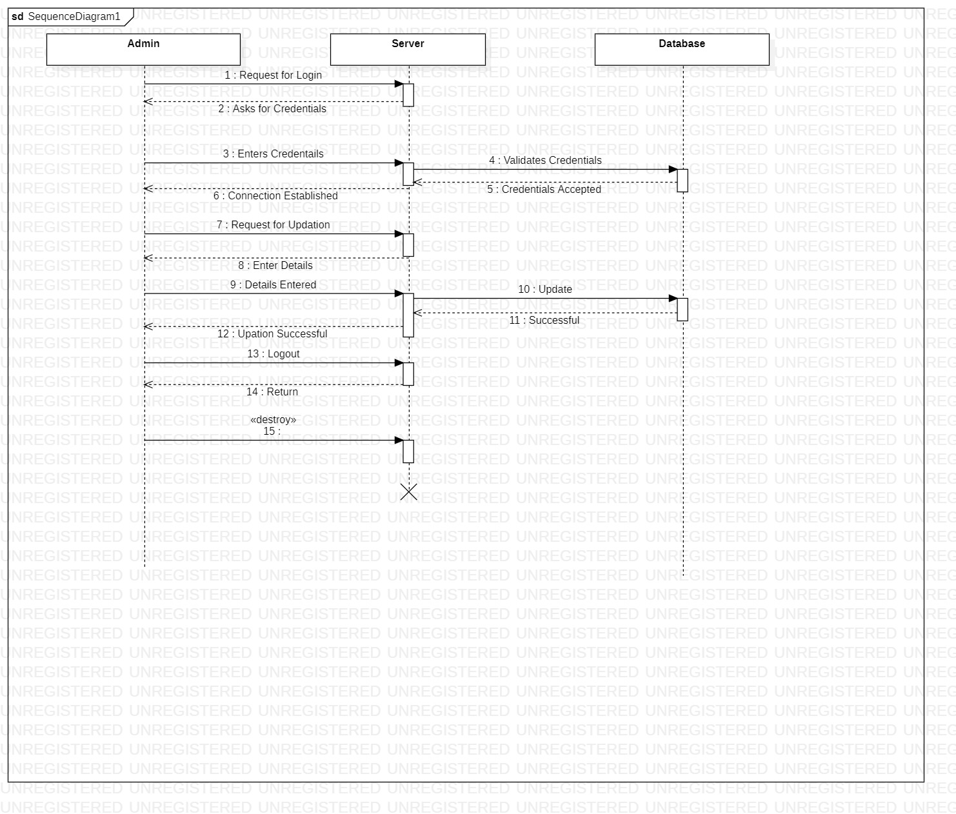
Sequence Diagram For Admin

Slide 11
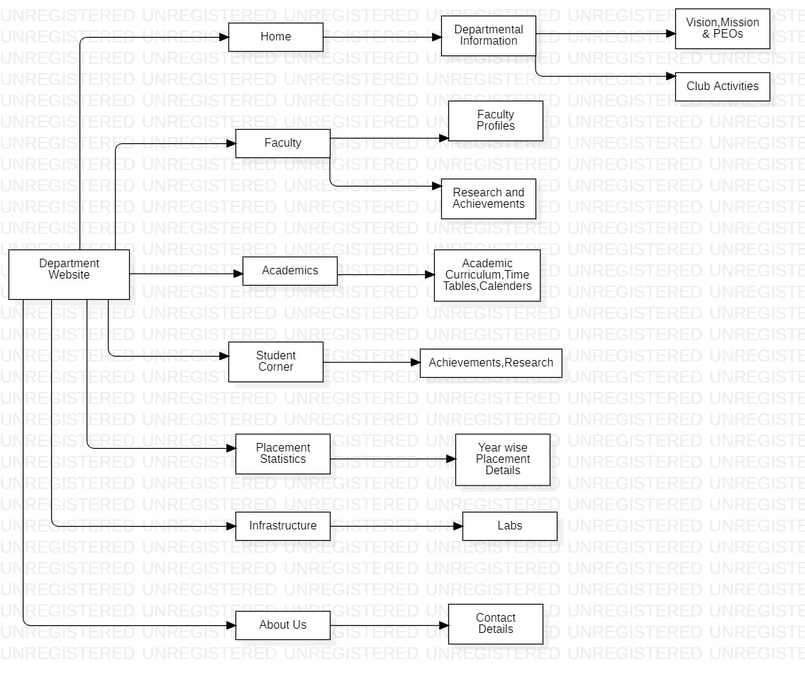
Structure Diagram

Slide 12
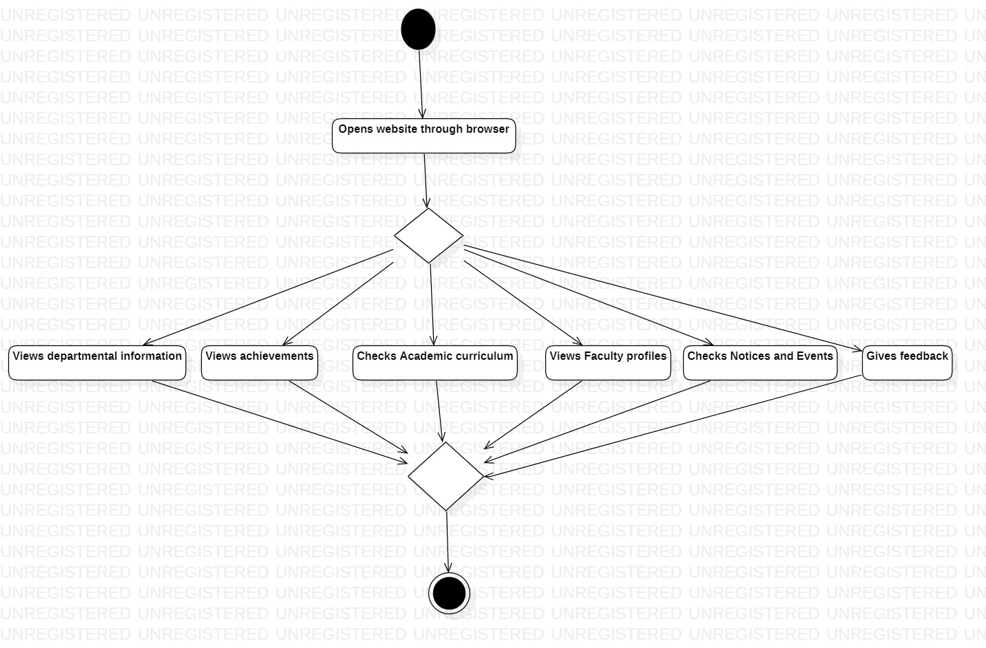
Activity diagram for User

Slide 13
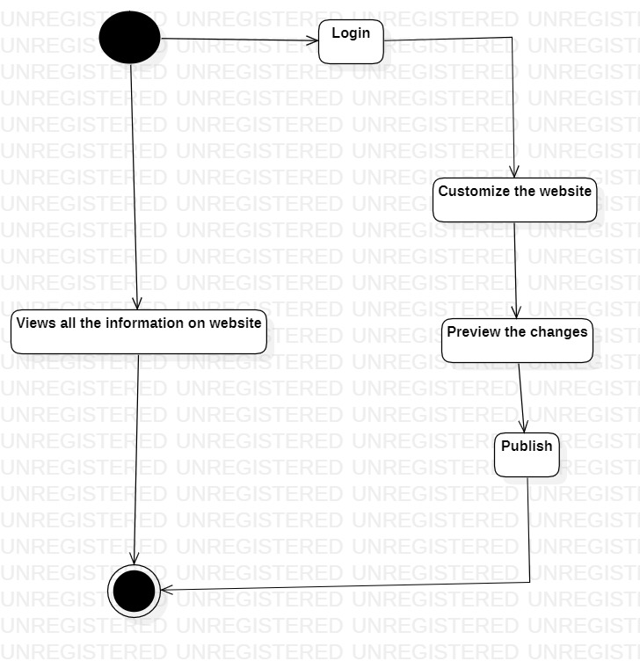
Activity diagram for Admin

Slide 14
Contribution
Information Gathering
Styling of Website

Slide 15
Contribution
Planning the Frontend of the website(User Interface)
Designing the Frontend
Development of Frontend

Slide 16
Contribution
Developing server and database.

Slide 17
Conclusion
A website (also written as web site) is a collection of web pages and related content that is identified by a common domain name and published on at least one web server
As technology advances internet is becoming ever popular. Website has become an essential part. Often website of an institution is used as major requirements to rate It.
Thus having a website is essential for any major organization.
As one of the department of a top private engineering college in Hyderabad, Department of Computer Science and Information Technology needs to have a useful and stunning website to showcase the department and use as a medium to interact with students, teachers and others.
Notices, research works , club activities, digital local library etc. can be the major advantages of a website.

Slide 18
Future Enhancements
This project will be extended by giving unique IDs and passwords for each and every student and faculty where students are mentored by the faculties on publishing the relevant tasks that are to be completed by the students.
This also involves adding better user experience and security features by using Authentication and Authorization.

Slide 19
THANK YOU

